Slide 1
Welcome to 1st Grade!
2020-2021

Slide 2
Tonight's Agenda (items to be discussed)
Standards
Curriculum
District Assessments – RI/MI/DIBELS
Classroom Assessments
Grading
Goal Setting
Reading Resources
Tech Tips
Copyright Resources
Contact Information

Slide 3
Grade Level Standards
All lessons adhere to GA Standards of Excellence for all subjects
Math –
  Unit 1
  Unit 2
  Unit 3
  Unit 4
  Unit 5
  Unit 6
ELA - https://www.georgiastandards.org/Georgia-Standards/Frameworks/ELA-Grade-1-Developmental-Progressions-R-W-SL-L.pdf

Slide 4

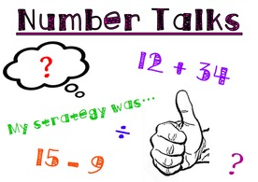
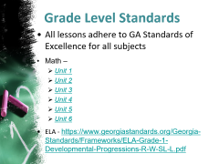
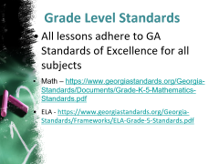
Curriculum
    Reading–
    Bookworms Reading – Shared, Interactive, DI
    Writing -
    First Grade Rubrics for Narrative, Opinion, and Informational
    Math –
    First Grade Number Talks Brochure
    Math Workshop

Slide 5
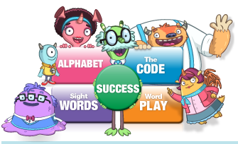

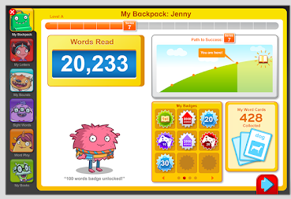
iRead
Meets the students where they are in their instructional literacy level.
Students log on during DI.

Slide 6

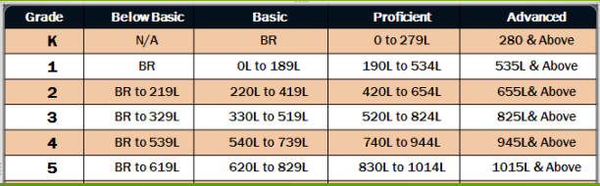
District Assessments –
The Reading Inventory is a low-stakes, classroom-based assessment designed to evaluate students’ reading ability, monitor their reading progress, and match students to books at their reading level.
The Reading Inventory is taken on a computer and lasts about 20 minutes. The types of questions a student receives and the results that are reported are based upon the student’s grade level and reading level.
Test Administration – 4 times a year (August, October, January, May)

Slide 7

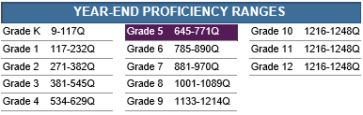
District Assessments –
The Math Inventory is a computerized test that results in a score, or Quantile® , that indicates how well a student understands mathematical skills and concepts along a developmental continuum. A student who scores at the Proficient level by the end of the school year is considered to be performing on grade level and is on track to meet the demands of college and career by the end of high school.
Test Administration – 3 times a year (August, December/January, May)

Slide 8
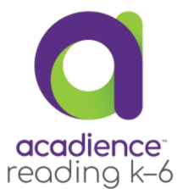
District Assessments –
Fluency is defined as the ability to read with speed, accuracy, and proper expression. In order to understand what they read, children must be able to read fluently whether they are reading aloud or silently. When reading aloud, fluent readers read in phrases and add intonation appropriately.
Reading fluency is calculated by taking the total number of words read in one minute and subtracting the number of errors.
Grade Level | 1 | 2 | 3 | 4
First | 0-31 | 32-46 | 47-66 | 67+
Second | 0-64 | 65-86 | 87-103 | 104+
Third | 0-79 | 80-99 | 100-117 | 118+
Fourth | 0-94 | 95-114 | 115-132 | 133+
Fifth | 0-104 | 105-129 | 130-142 | 143+

Slide 9
Classroom Assessments
Edited by Teachers

Slide 10
Grading Scale
Grades are on a 1-4 scale.
4 | 3 | 2 | 1
Exceeds Mastery: Student applies the skill or concept independently and correctly; communicates higher level thinking or skill level significantly above grading term expectation. This score is a Satisfactory score. | Demonstrates Mastery: Student applies the skill or concept independently and correctly; communicates clear understanding at grading term expectation. This is a Satisfactory Score. | Progressing Towards Mastery: Student applies the skill or concept with support/not independently; communicates some understanding but is not currently meeting grading term expectation. This is an Unsatisfactory score. | Limited or Minimum Progress: Student has limited ability to apply the skill or concept, even with support; communicates limited understanding and is not currently meeting grade term expectations.
Progress Reports Issued: November 13th – 2nd 9 weeks March 19th – 3rd 9 weeks June 2nd – 4th 9 weeks
Report Cards Issued: October 16th – 1st 9 weeks January 5th – 2nd 9 weeks March 19th – 3rd 9 weeks June 2nd – 4th 9 weeks

Slide 11
Goal Setting
G - Growth
O - Ownership
A - Awareness
L - Learning
“Setting goals is the first step in turning the invisible into the visible.”
-Tony Robbins
Leverage parent support: If we want students (especially our youngest ones) to set goals that have any personal meaning, those goals need to be transferrable from school to home. In this sense, parents are a key player. Goals that are meaningful for both students and parents are key in fostering long-term growth.
-Journal of Research in Childhood Education

Slide 12
Grade Level Goal
Know all 200 sight words and read on grade level at 60 words correct per minute with a minimum 88% accuracy.
WAYS TO ASSIST AT HOME
Focus on five to ten sight words each night with your student.
  Set a timer for your students to see if they can “beat the timer”.
  Create flashcards of the high frequency words your students do not know.
  BAM! -

Slide 13
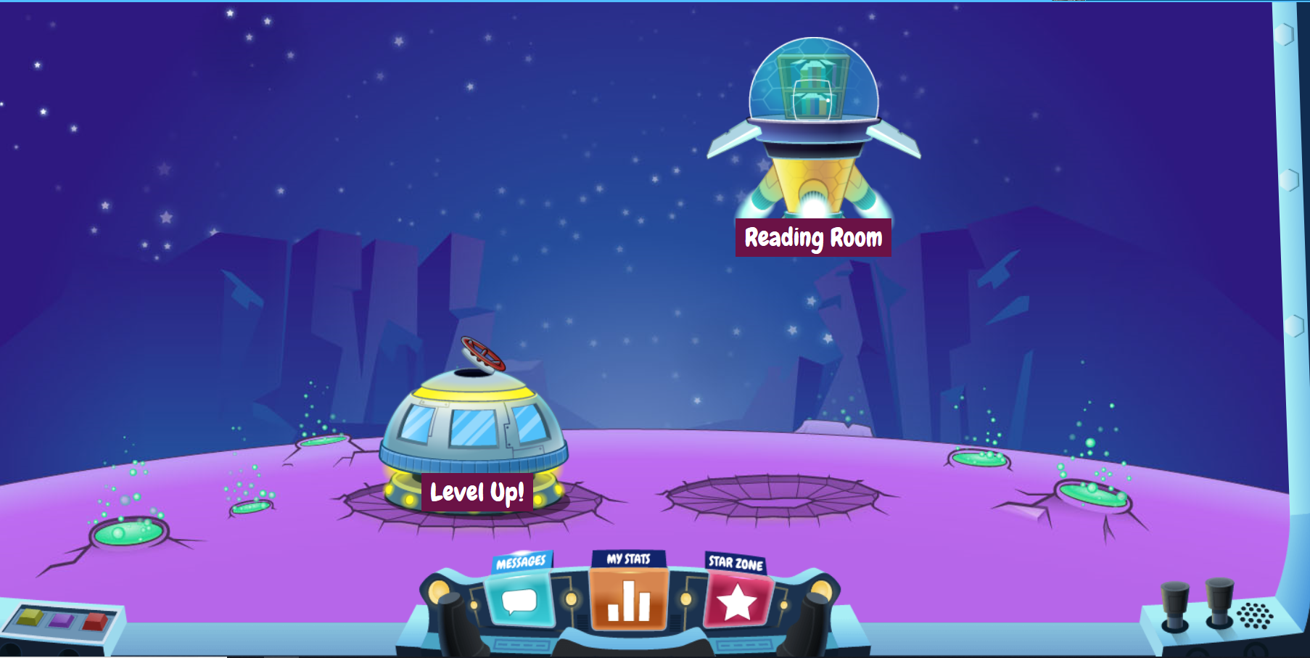
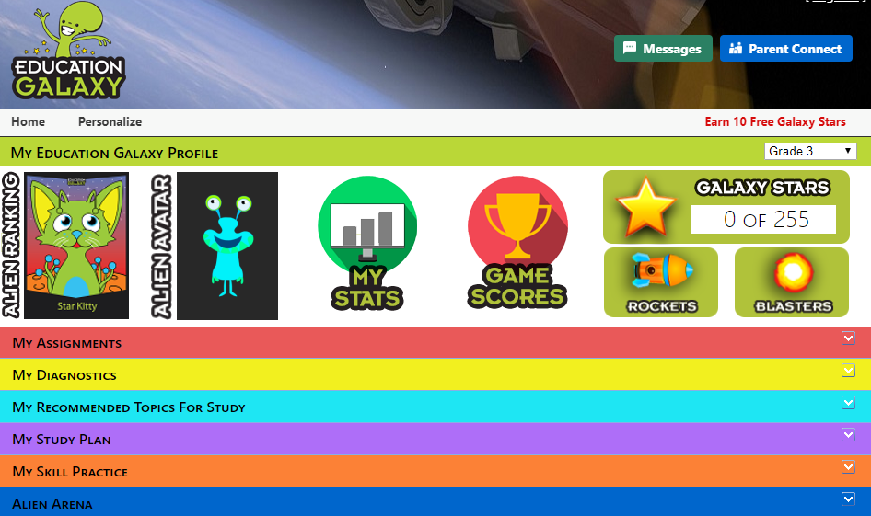
Reading Resources
RazKids - https://www.raz-kids.com/
  Online practice on literacy standards and skills
  Teacher login: Contact Teacher
  Student login: Lunch number
Education Galaxy – www.educationgalaxy.com
  Students can practice Reading Standards in an engaging online setting.
  Student login – Student ID # + hes (i.e. 123456hes)
  Student Password – Student ID # (i.e. 123456)

Slide 14
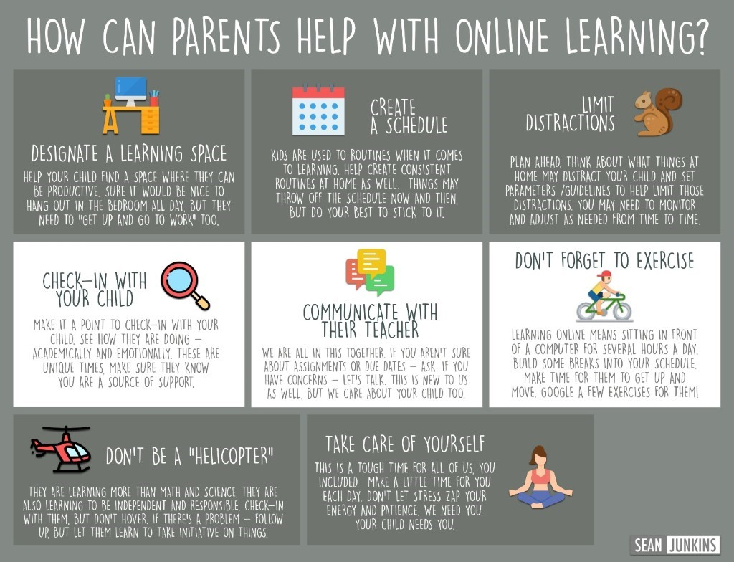
Tech Tips –Online Learning

Slide 15

Tech Tips – cont’d
Canvas Student Login –
  Student login - Student ID # @paulding.k12.ga.us
    (i.e. 12345@paulding.k12.ga.us)
  Student Password – first initial + middle initial + last initial and 4 digit birthday (month and day)
    (i.e. abc0102)
Canvas Parent Help Guides -
https://community.canvaslms.com/t5/Observer-Guide/tkb-p/observer
Information for Digital Learning Days – short term and/or long term (pivot) - https://www.paulding.k12.ga.us/Page/42513

Slide 16
What is Copyright?
Did you know that whenever you write a poem or story or even a paper for your class, or a drawing or other artwork, you automatically own the copyright to it. Copyright is a form of protection given to the authors or creators of "original works of authorship," including literary, dramatic, musical, artistic and other intellectual works. What that means is that, as the author of the work, you alone have the right to do any of the following or to let others do any of the following:
- make copies of your work;
- distribute copies of your work;
- perform your work publicly (such as for plays, film, dances or music);
- display your work publicly (such as for artwork, or stills from audiovisual works, or any material used on the Internet or television); and
- make “derivative works” (including making modifications, adaptations or other new uses of a work, or translating the work to another media).
In general, it is illegal for anyone to do any of the things listed above with a work created by you without your permission, but there are some exceptions and limitations to your rights as a copyright holder. One major limitation is the doctrine of “Fair Use”.
Student Guide for more information on copyright - http://www.copyrightkids.org/cbasicsframes.htm
Parent Guidance for more information on copyright - https://parentingdigital.com/parents-guide-copyright-fair-use/

Slide 17
Contact Information
Feel free to reach out to your child’s teacher with questions.
You may also contact your school’s Instructional Lead Teacher:
2020 Title I Schools

Slide 18
